Slide 1
Сучасні освітні тенденції і технології, інструменти розвитку креативного мислення
Вчитель англійської мови: Токарюк Марина Миколаївна

Slide 2
Креативні батьки, діти та вчителі
Нерідко батькам би хотілося, щоб їхні діти були креативними. Знаходили нестандартні рішення проблем, вільно себе почували у всіх сферах мистецтв, мали відчуття стилю і займалися цікавою справою, до якої підходили творчо.
Але не менше хочеться, щоб діти слухали нас і вчителів, слідували чіткому розпорядку дня і правилам, не створювали нікому проблем, не відволікали від важливих справ і навіть одягалися так, щоб милувати наше око.
Тільки все це не про креативність. Бо креативна дитина зовсім "не зручна", вона не любить послуху і робити так, як інші.
Творче або креативне мислення — це нестандартний, оригінальний тип мислення, здатний привести до несподіваних рішень чи нових відкриттів. Воно потрібне у кожній професії: в ІТ, в торгівлі, військовій справі, журналістиці, юриспруденції.
Натомість сучасна система освіти побудована так, щоби плекати не креативних людей, а добрих виконавців. Вони мають беззаперечно підкорятися волі вчителя (начальника), не ставити зайвих питань, ретельно виконувати уроки (роботу), які для них визначив хтось інший.

Slide 3
Що нам робити щоб діти росли креативними?
У 1990-х роках у США досліджували, наскільки діти різного віку використовують свій творчий потенціал. Результати показали, що у віці 3-5 років діти мислили креативно у 98% випадків.
Згодом тих самих дітей перевірили у віці 8-10 років — лише 32% з них використовували вповні свій творчий потенціал.
Група 13-15-літок мислила творчо лише у 10% випадків. А велика вибірка 25-літніх — лише у 2% випадків.
Такий результат може свідчити про те, що ми вчимо дітей все "робити правильно" і не шукати власних відповідей і рішень. А коли є єдино правильний шлях — починаєш панічно боятись помилок.
Ми порівнюємо дітей між собою і рівняємо на "кращих" (зокрема, відкритою системою оцінок).
І хоча чимало вчителів намагаються розвивати дитячу креативність, їм нелегко боротися з системою, та ще й знаходити на це час в геть перевантаженій навчальній програмі. Тому дуже важлива роль у цьому процесі лягає на плечі батьків.

Slide 4
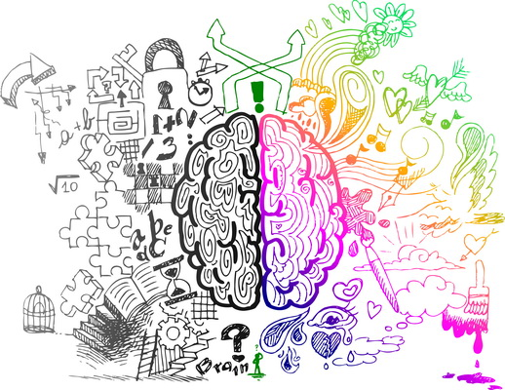
Правила креативності
НЕ ОБМЕЖУЙТЕ БЕЗЛІЧЧЮ ПРАВИЛ
ЗНАЙОМТЕ ДИТИНУ З КУЛЬТУРОЮ І МИСТЕЦТВАМИ
ГРАЙТЕ З ДІТЬМИ
ВИГАДУЙТЕ ВАРІАЦІЇ
ПОКАЖІТЬ РІЗНОМАНІТТЯ ЗАНЯТЬ
ФОРМУЙТЕ ПОЗИТИВНЕ СПРИЙНЯТТЯ СВІТУ
НЕ ПЕРЕВАНТАЖУЙТЕ ДІТЕЙ

Slide 5

Будьте креативними
В наш час все частіше виникають питання як зацікавити учнів до навчання, як провести урок, аби не просто привернути увагу учнів до теми, але і стимулювати їх до вивчення цієї теми.
Користуйтеся своїми творчими навичками! Будьте креативними!

Slide 6
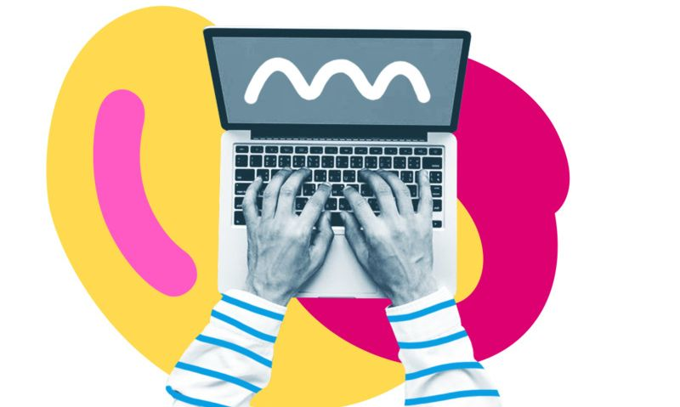
Застосування на практиці
Проектні роботи на тему «Винаходи та винахідники наших днів» учнів 10 класу.

Slide 7
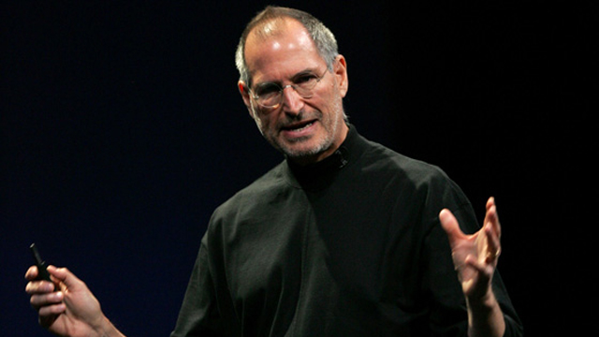
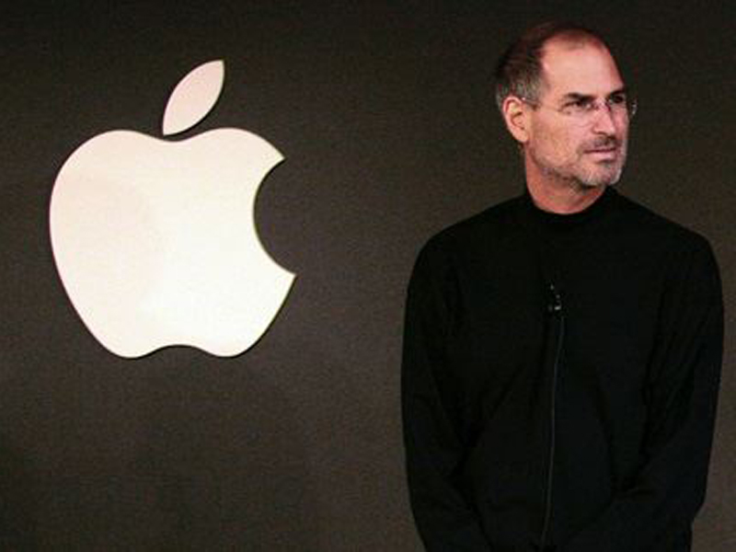
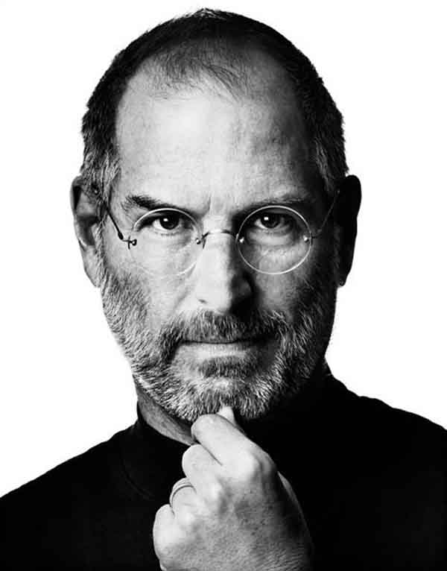
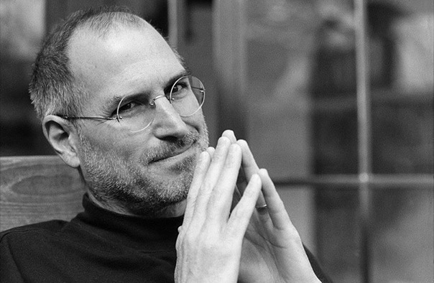
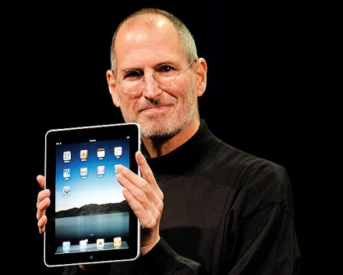
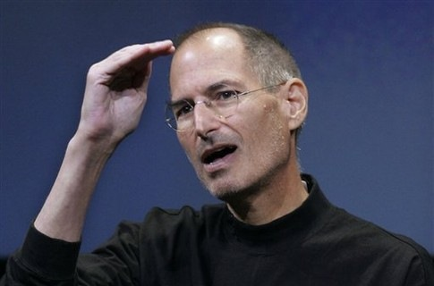
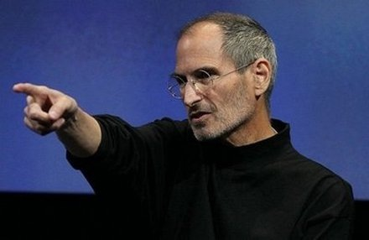
Steve Jobs.

Slide 8
History of creation of the company apple

Slide 9
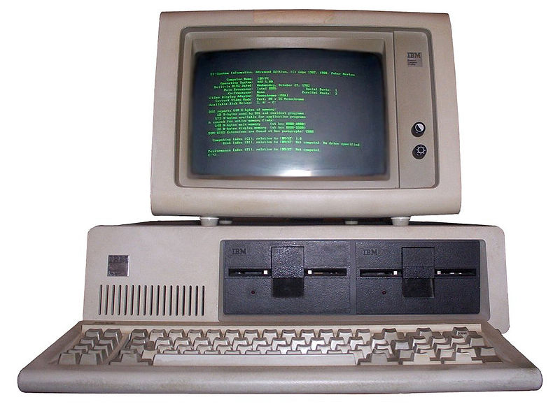
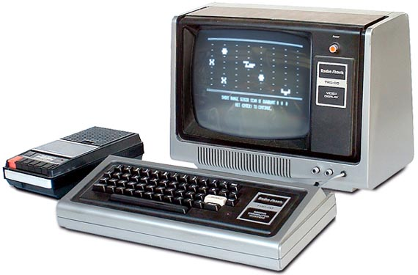
The history of this legendary company has begun in far 1970, with two enterprising young men Steve Jobs and Steve Voznjaka, started to trade in the first self-made personal computers.
Business has gone uphill and in 1976, having received financing, company Apple has been organized.

Slide 10
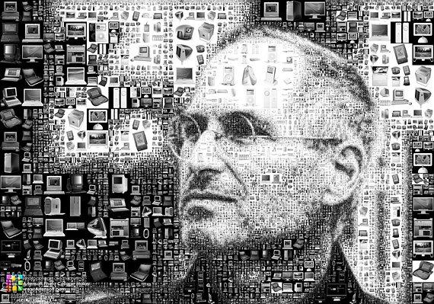
In those of year, personal computers gathered, basically enthusiasts under the various schemes published in magazines.
Modular computers, such as Commodore, certainly, too were, but they were on sale, at first, not so in large quantities. And only with an exit of personal computer Apple 2, it was already possible to speak about mass character, after all models of these computers were issued by millions.

Slide 11
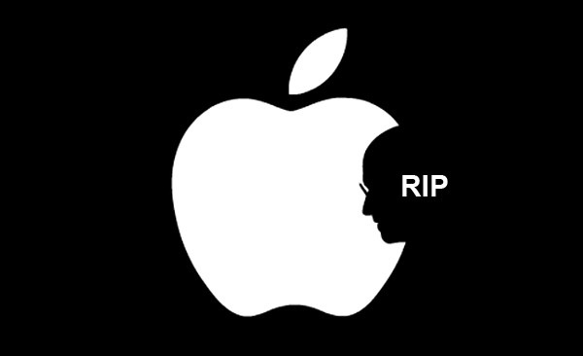
Till 1980, various updatings of successful child Apple ll were on sale basically.
In 1980 the new computer from ruler Apple – Apple lll has been let out, but for some reasons its sales were not so successful as its predecessor.

Slide 12
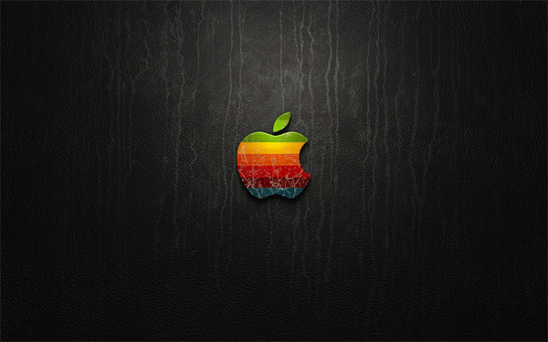
The history of this legendary company has begun in far 1970, with two enterprising young men Steve Jobs and Steve Voznjaka, started to trade in the first self-made personal computers.
Business has gone uphill and in 1976, having received financing, company Apple has been organized.

Slide 13
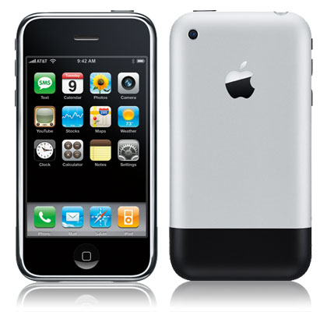
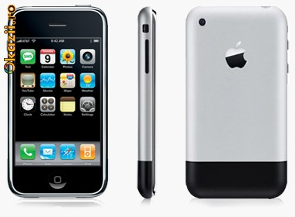
In October, 2001, the first has been presented iPod, making deafening success all over the world. By 2007, it has been sold about 110 million players of this company.
Same 2007, the company has gone further, having presented to the world the new creation – iPhone 2G, which, already by the developed tradition as has made furor.

Slide 14
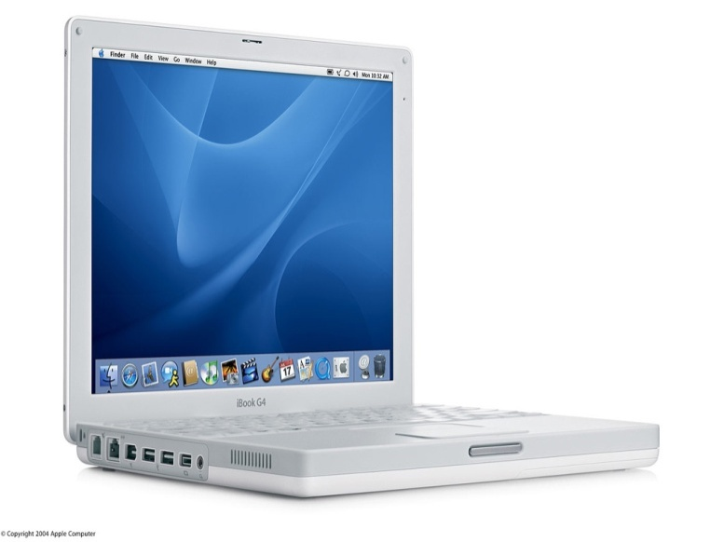
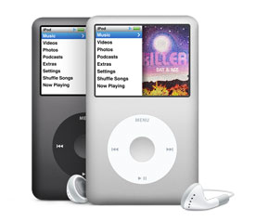
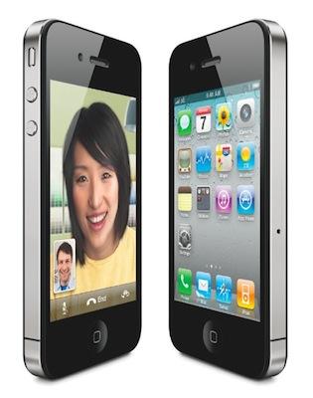
Now the company develops these directions.
Worldwide products of this company – computers Macintosh are on sale – now have removed to professional circle of designers and developers.
Computers iMac – personal computers for a wide range of consumers.
Laptops iBook. Players iPod 6 and 7 generations, and also iPhone 3 and 4 generations.

Slide 15
Steve Jobs's citations

Slide 16
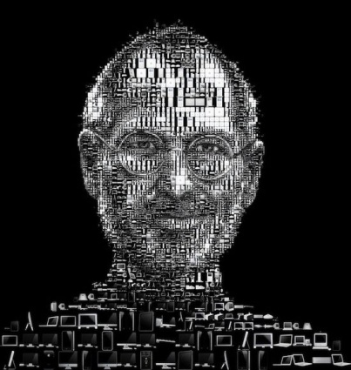
"Nobody wants to die. Even people who want to get on heavens do not want to die. And all the same, death – destination for all of us. Anybody never could avoid it. And should be, because Death, probably, the best invention of Life. It – the reason of changes. It clears old to open road to the new. Now new are you, but once (not very much and long remains) – you become old and you will clear. Forgive for such dramatic nature, but it is truth."
If you live every day as if it last, sometime you will appear are definitely right

Slide 17
— There is no such concept as the successful person who has never stumbled and has not committed an error. There are only successful people who have committed errors, but then have changed the plans, being based on these errors. I just one of such guys.
— Don't allow noise of another's opinions to interrupt your internal voice. And the most important: have bravery to follow the heart and intuition. They somehow already know the one whom you want to become actually

Slide 18
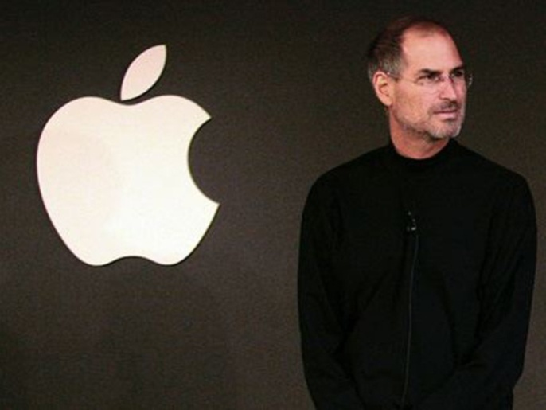
You learn that search, when will find.
Problem in that I became more senior and has understood that technological novelties aren't capable to change the world really. Excuse, but it is truth. This understanding comes with the advent of children. You are born, grow old, and then die. And so there are many years. And it won't change anything

Slide 19
Three apples have changed our world: with the first have tempted Eve, the second has woken Newton, and the third has caught sight to Steve Jobs.

Slide 20
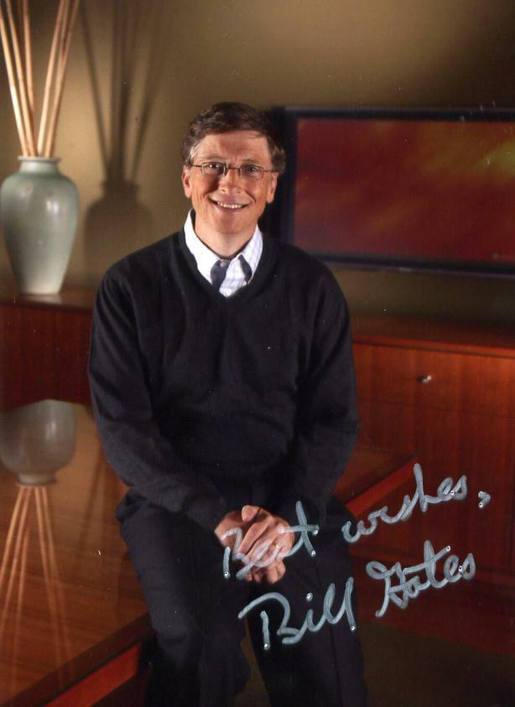
Bill Gates,
the man who changed the world!

Slide 21
Stubborn genius
Bill Gates was born October 28, 1955 in Seattle, Washington, USA. He was the first born and only son in a family of well-known lawyer.
This modest, even shy and slightly foolish boy wanted to become a professor of mathematics and was not like his father - a high handsome and successful lawyer. Despite the unique abilities in mathematics and logic, Bill Gates showed leadership skills inherent to his parents.

Slide 22
From birth Gates had three talents: brilliant memory (read the three-page text once, he could transfer his heart), mathematical ability and persistence ... donkey. As a child, Bill constantly arguing with their parents. When the "ancestors" ended arguments, they enlisted the help of a psychologist. After treatment, the psychologist has reported them coldly, "You just have to adapt, because you lose time trying to beat it." From that day nearly gave Bill, realizing that their family is growing personality.

Slide 23
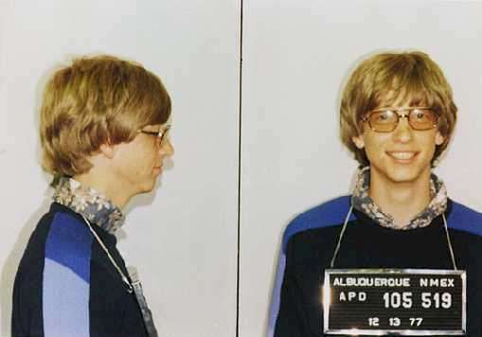

Slide 24
Bill Gates independently studied programming language BASIC - the textbook. Hobbies fully shared by Bill Paul Allen (Paul Allen) - his best friend. The second program Bill was playing "tic - Crosses". A little later, Gates was established strategy computer game in which the object was - to achieve control over the entire planet.
In the ninth class, according to a mathematical test, he was one of the best students of the country.

Slide 25
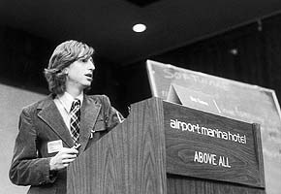

Slide 26
While still a student, William Gates, along with his close friends Paul Allen and Kent Evans (Kent Evans) with the company Lakeside Programmers Group. The first order was to create a company newly payroll program. It was at this moment between Bill and Alain conflict occurs first. The result - Gates reveals its leadership and establishes its superiority to the common cause.
Gates and Allen Evans was established company Traf-O-Data, which was engaged in the analysis of traffic in the city and making custom graphs. Revenue from the project was 20 000 dollars.

Slide 27
Earned first twenty thousand dollars, he stopped going to school and offered to satisfy his management computer programs as coursework. Teachers understand: student, able to develop a program for a computer - a gifted student, and gave him a free hand. So the richest man on the planet does not have full secondary and higher education.

Slide 28
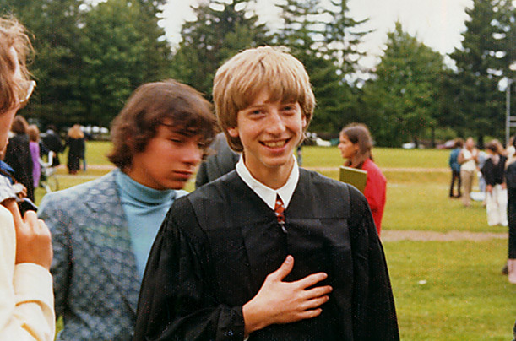
In 1973, Bill Gates goes to Harvard for further studies. In parallel studies, along with Allen, he studied computer programming language and is developing versions of the language BASIC for the first PC. By the way, at Harvard, Bill met his future successor as director general of Microsoft, Steve Ballmer. But two years later he left for training sessions and programming has been deducted.

Slide 29


Slide 30
In 1975 Gates together with Paul Allen founded the company Micro-Soft. Bill Gates and Allen offered to write them a firm MITS software (version BASIC) for their computer Altair 8800. This was the first order of future software giant. The first five customers Microsoft have gone bankrupt, but the guys are not merged into despair. Only four years hard work and success came - in 1979 the company received an offer from IBM to create operating system for the world's first personal computer. Bill Gates bought QDOS system for 50 thousand. Dollars, changed its name to MS-DOS and sold license IBM. The money raised will allow Microsoft to work for several years. Presentation of the new IBM PC software Microsoft has created a sensation in the market. Many companies have started to refer to the Microsoft license.
Microsoft went on to capture the world market, releasing the program Microsoft Word and Microsoft Excel.

Slide 31
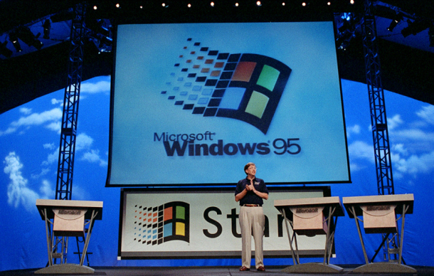
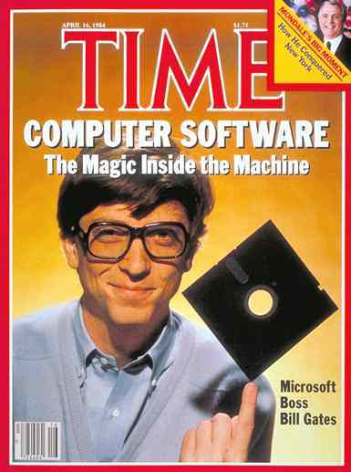
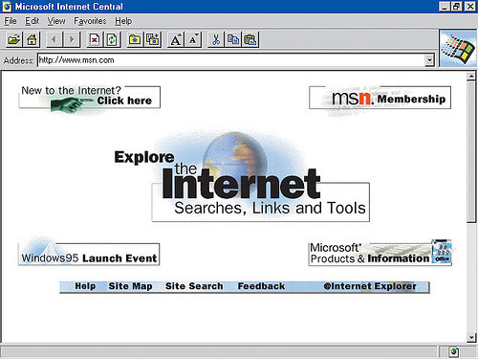

Slide 32
In 1986, William Henry Gates is a billionaire (at the time he was 31 year), and the company Microsoft - joint-stock company. Next year, Microsoft released the first version of the world of Windows, and in 1993 the total sales of Windows in one month exceeded milyon.U 1995 appeared Windows95, and two weeks have been sold seven million kopiy.Prohramne Microsoft software has become so widely used the company came to the attention of the US antitrust committee that tried several times to initiate proceedings against the forced destruction monopoly of Bill Gates. But the result was useless.
In 1995, the policy was changed radically Microsoft - the emphasis was made on time internet.Tym man who has managed one of the first to understand that computerization - one of the great revolutions, do not stop there. The genius of science not forgotten how to dream. He has sold almost goal marked the beginning of his way, "computer - for each desktop in every home", making it advances in technology accessible to all.

Slide 33
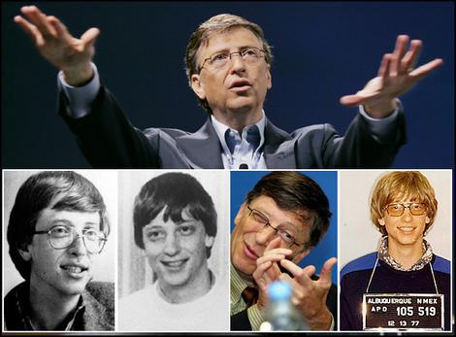

Slide 34
Computers

Slide 35
Every day many people use computers in different areas: medicine, science, business, at school and at home.
Every teenager knows how to use this machine and do it very successfully.

Slide 36
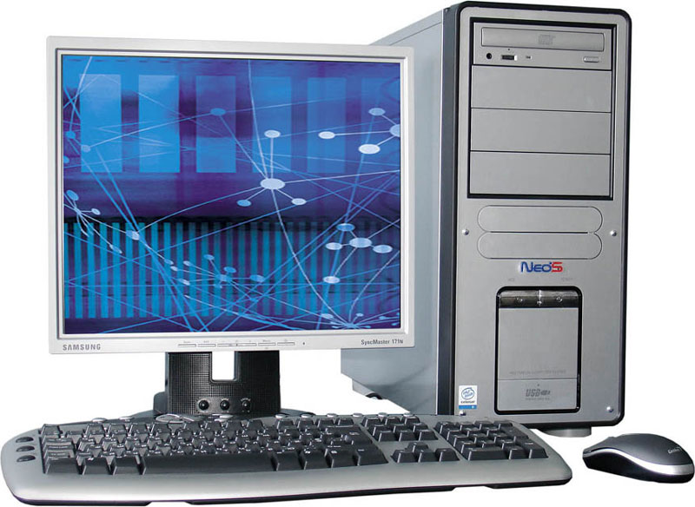
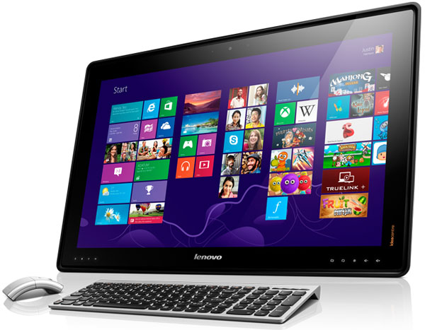
All people can not imagine their life without computers, because it helps and entertains us.

Slide 37
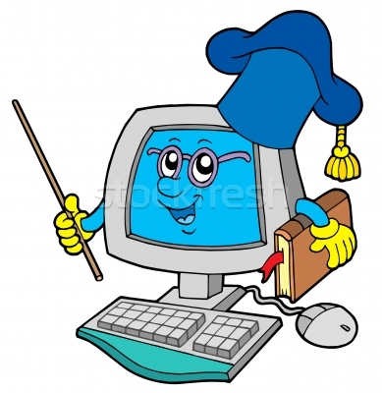
Every day people use computer and don’t know what big job they do with help computers. With its help we can discover new things, new medicine and disease, very fast count and do incredible things with text or with information.

Slide 38
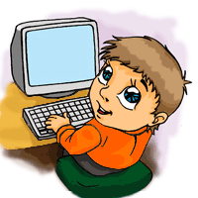
At school we have Informatics and work on computers on these lessons. We looking reports, scientific articles, listen to music, play game, doing a great work on the computers.

Slide 39
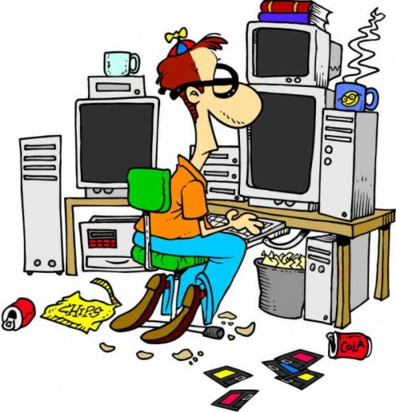
Computer has many good qualities but despite this its harm young people. For example it takes much time, spoils vision, children become lazy.

Slide 40
We will never imagine our life without computers because its a big useful progress in technologies in such a short time.

Slide 41
«Найвище завдання будь-якої творчості – знайти незвичайне в звичайному і звичайне у фантастичному»
Дідро

